Slide 1

Adverbs of Frequency
5
Study Habits

Slide 2
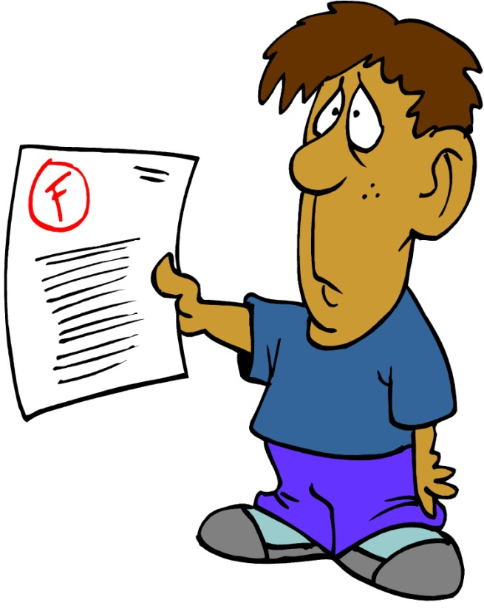
Study Habits
Well, I always do my homework, and I often ask the teacher for help.
Hmmm… Well, I am usually late for class, and I never do my homework.
Maybe I need to try your study habits.
You got an “A+” again!?!? How do you do it?
I got an “A+.”
I got an “F” again.

Slide 3

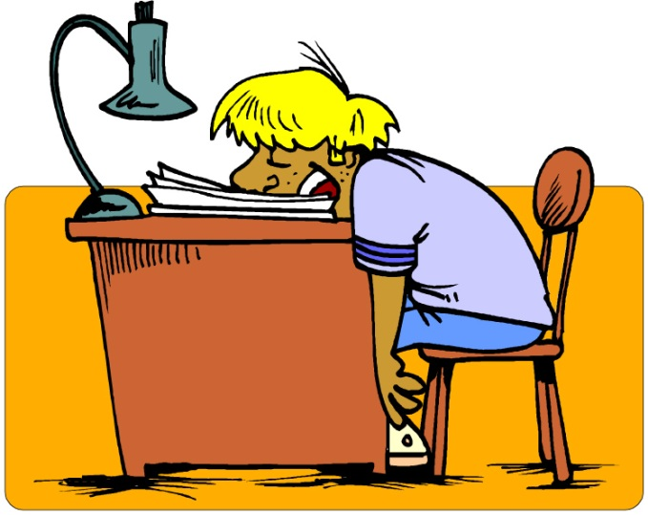
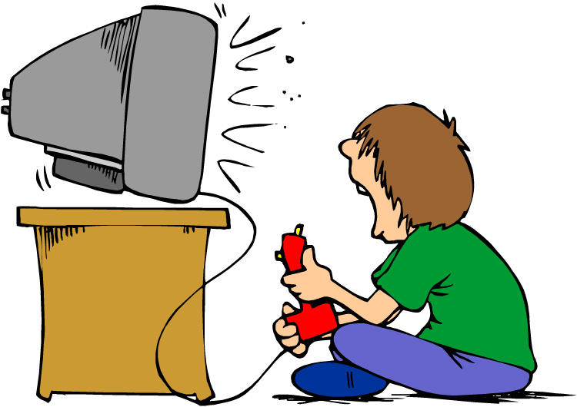
Adverbs of Frequency 1
Adverbs of frequency say how often something happens.
100%
always
usually
often
sometimes
50%
He always studies.
He rarely studies.
rarely
usually
He sometimes studies.
never
never
often
0%

Slide 4


Adverbs of Frequency 2
Adverbs of frequency come after the verb be.
She is sometimes late.
The students are never bored.

Slide 5


Adverbs of Frequency 3
Adverbs of frequency usually come before other verbs.
She often checks her answers.
He usually pays attention in class.

Slide 6
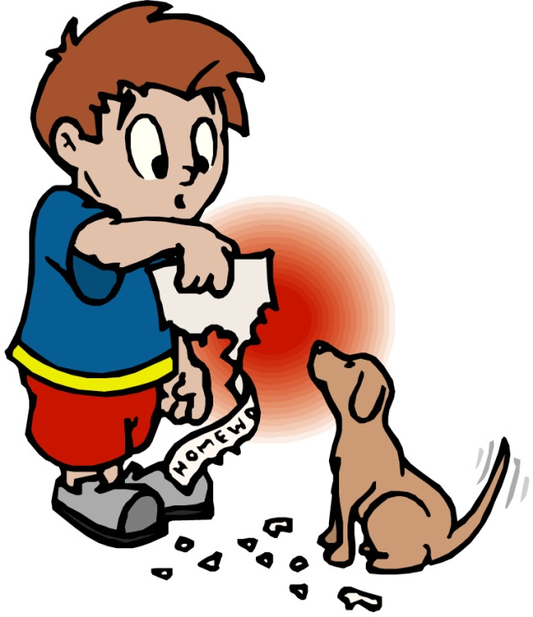
Usually and Sometimes
Usually and sometimes can also come at the beginning or end of a sentence.
The dog eats his homework sometimes.
Sometimes the dog eats his homework.
The dog sometimes eats his homework.

Slide 7
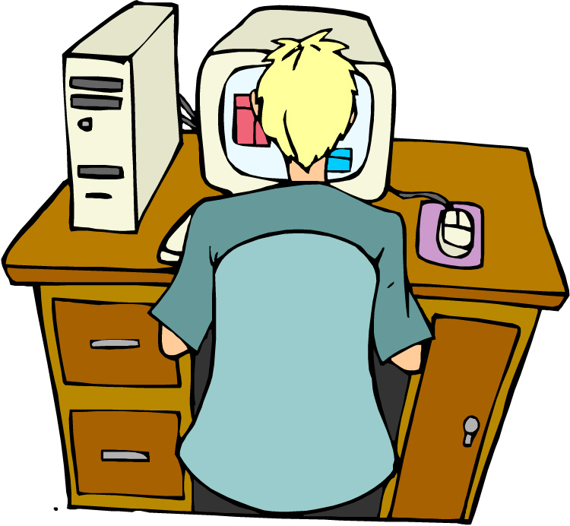
Practice 1
Work with a partner. Describe your study habits. Use adverbs of frequency and the phrases below.
Example: study at my computer
study in front of the TV
ask the teacher for help
be early to class
review my grammar notes
make flashcards
be attentive in class
I sometimes study at my computer.
100%
always
usually
often
sometimes
50%
rarely
never
0%

Slide 8
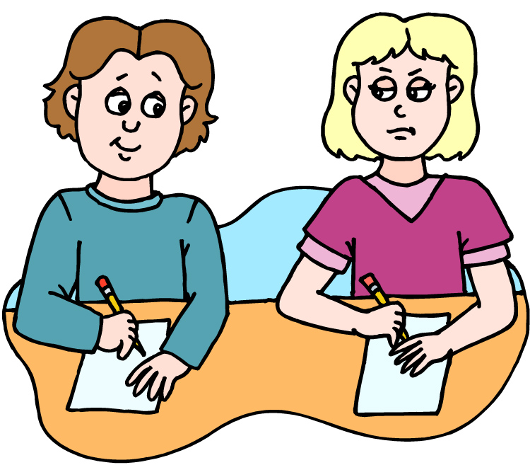
Questions with How Often
Use how often to ask about frequency.
How often do you study with a partner?
I rarely study with a partner.

Slide 9
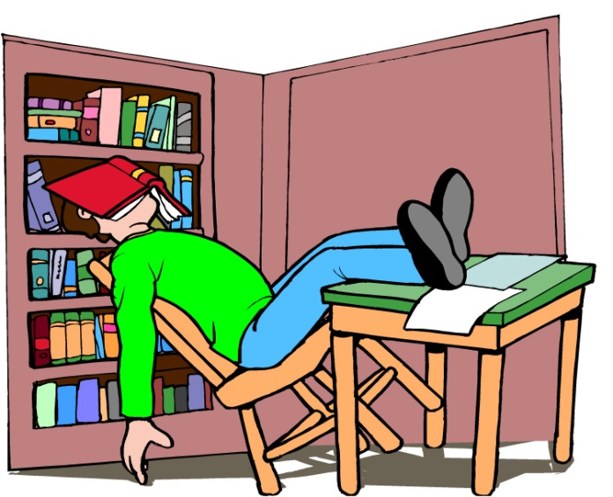

Practice 2
With a partner, ask questions with how often. Follow the examples.
How often _______ you…
Example:
fall asleep studying
be tired
study in a group
be bored in class
listen to the teacher
practice speaking English
get an “A” on a test
be confused in class
How often do you fall asleep studying?
How often are you tired?

